Slide 1









2D Tennis Game
By MD. Imran Hosen
iD: IT24060
Instructor:Lecturer Mr. Mahedi Hasan Sir
Department of ICT,MBSTU

Slide 2


Introduction
• This project is a 2-player tennis game made with C++ and SFML 3.0.
• Inspired by the classic Ping Pong game.
• Main objective: score 10 points before the opponent.

Slide 3
Tools & Libraries
Language: C++
Graphics Library: SFML 3.0
Compiler: VS Code
Font: Arial (for score display)

Slide 4



Game Elements
Player 1 Bat – controlled with W / S keys
Player 2 Bat – controlled with Arrow Up / Down
Ball – moves automatically with velocity
Score System – displays live score (e.g., 3 : 2)

Slide 5
Core Code Features
Event Handling → Window close with Event::Closed
Movement → Keyboard input for bat
Physics → Ball bounces on top/bottom walls
Collision Detection → Bat-ball collision via intersects()
Score Update → Resets ball & increments player score

Slide 6
Gameplay Rules
Ball starts at center.
Players move paddles to prevent ball from passing.
Ball bounces back when hit by bat.
Game ends when any player scores 10 points.
Winner shown as → “PLAYER X WIN”

Slide 7
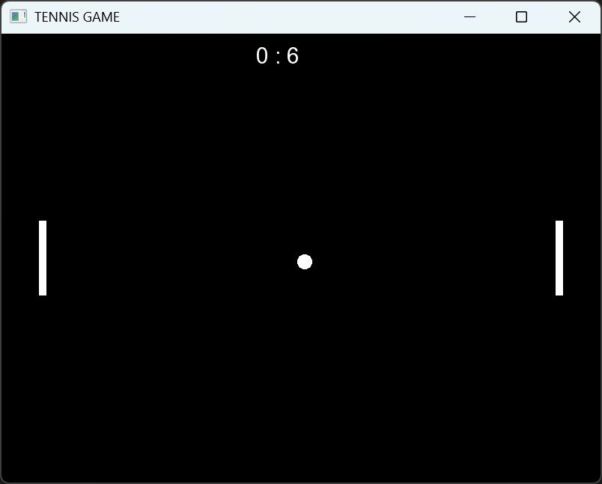
Demo

Slide 8

Challenges & Solutions
Challenge: Ball-bat collision → Solved using bounding box check
Challenge: Restrict bats inside window → Position checks before moving
Challenge: Score updating → Used Text + string conversion

Slide 9
Thank You
For Your Attention
Presented by:
MD. Imran Hosen

